Slide 1

SAVE THE EARTH FROM ANOTHER CARRINGTON EVENT
Team RoboTO – NASA International Space Apps Challenge
Matteo Abbamonte, Alkis Koudounas, Vittorio Mayellaro, Francesco Paoli Leonardi

Slide 2
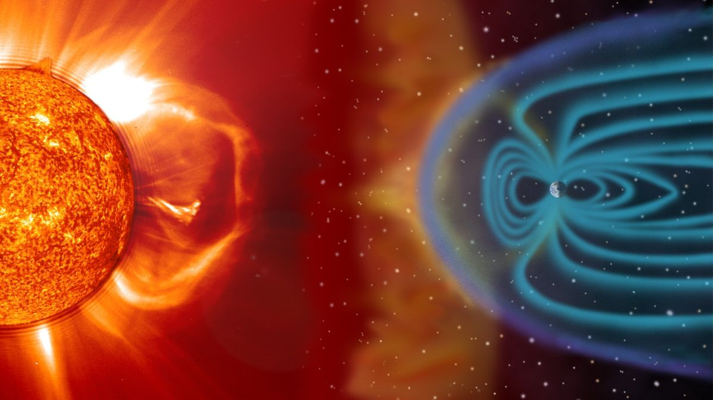
The Carrington event
On the night of the 28th of August 1859, skies around the world lit up.
The Carrington Event was the most intense geomagnetic storm in recorded history. It was caused by a series of two solar flares.

Slide 3

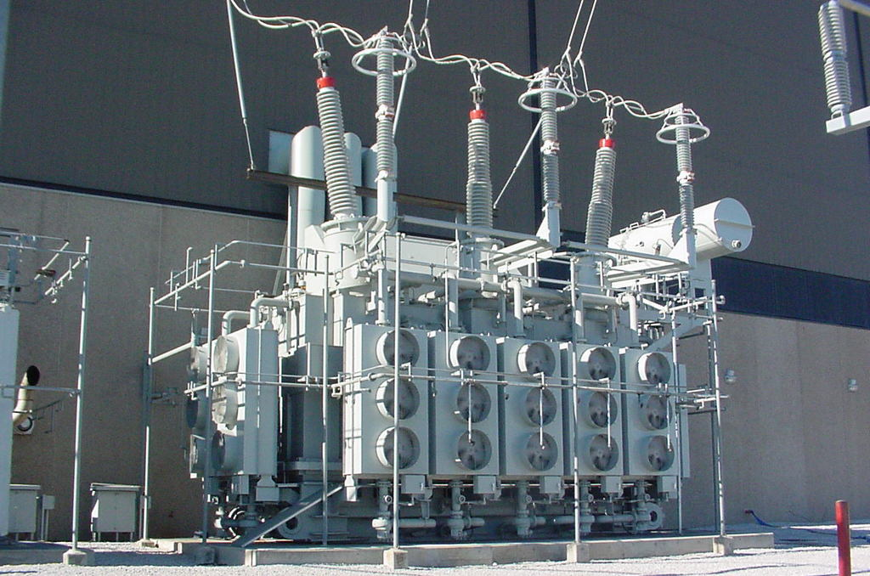

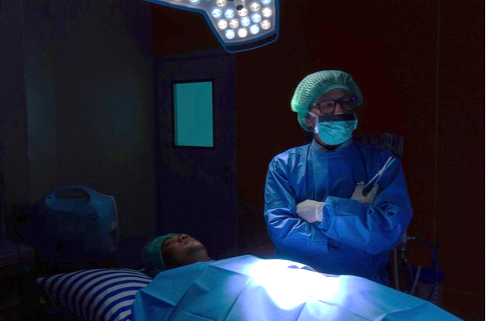
what if a Carrington-level event were to happen today?
Most extensive blackout ever seen: loss of power, communications, and the failure of most modern technology.
The biggest geomagnetic storm in recorded history happened more than 160 years ago. Now, we’re entering another period of solar maximum.
Planes would be grounded
Power plant transformers would be irreparably damaged
Card-based transactions would be impossible
Hospitals would be left in the dark

Slide 4
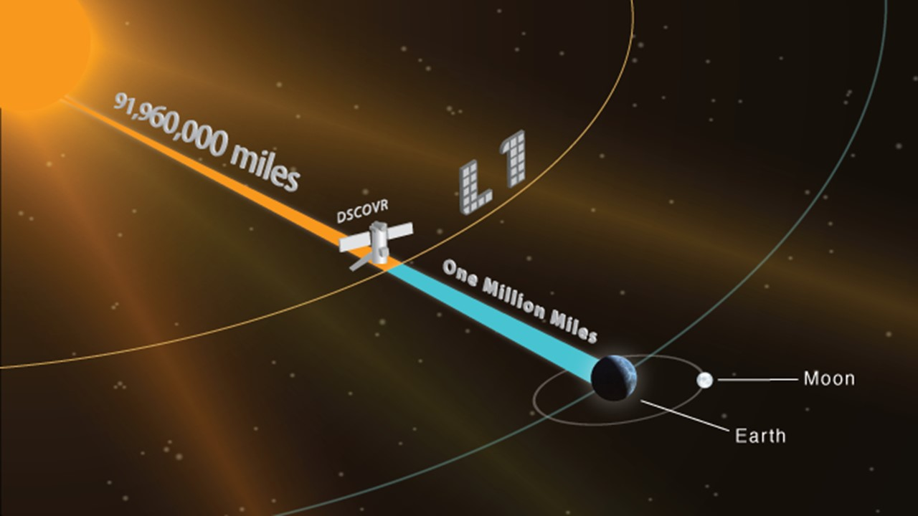
what our proposal is
In 2015 NASA launched the DSCOVR spacecraft to monitor solar winds. The Faraday’s Cup on it is a little quirky: it is measuring also other things that it shouldn’t be.
In that year NASA tried lots of classical approaches to correct this problem without significant success.
We developed a deep learning architecture able to leverage the ground truth from the best-calibrated Faraday Cup, getting the same quirky inputs and returning the correct outputs that enables DSCOVR to provide early warnings of the next potential Carrington-like event.

Slide 5
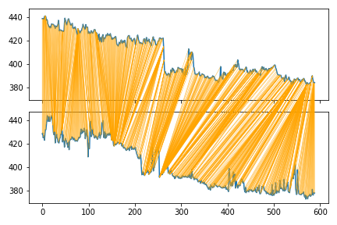
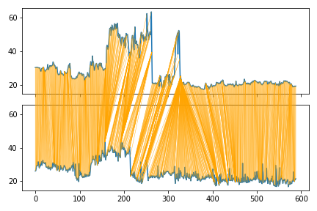
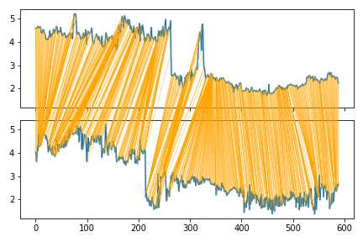
FIRST STEP: DATA interpretation and PRocessing
Understand the operative meaning of the data structures, retrieving the appropriate quantities to be later collected.
Collect Wind and DSCOVR ion parameters (density, temperature, velocity) available on NASA archives, from June 2016 to June 2019.
Clear the data from the outliers.
Re-alignment of sampled data originally acquired at different, non constant, sampling times, in different capture windows, enabling the data sequences to have the same number of elements.
Velocity
Thermal speed
Density

Slide 6
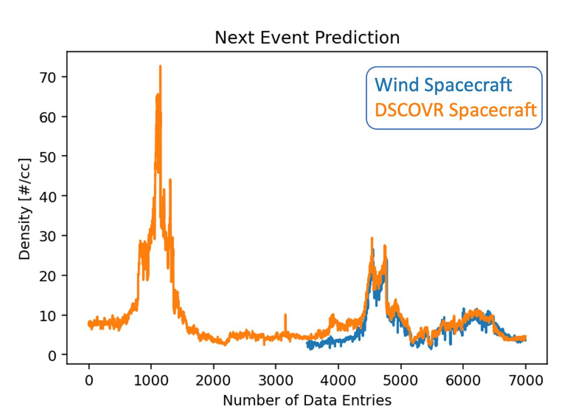
second STEP: MODEL TRAINING and TESTING
Apply BERT, a state-of-the-art deep learning approach to a completely new domain.
Define an end-to-end framework that addresses two goals: (1) Aligns the DSCOVR measurements to the WIND‘s one, allowing the former to increase its performance in solar data modelling. (2) Next-Event-Prediction: allows to predict the next solar wind peak with a certain early warning.

Slide 7
conclusions
The end users for whom this solution was developed are Space Agencies and Space companies in general.
Our main focus, during the 24 hours challenge, has been to find an innovative solution to a complex issue.
Further optimizations and training of the model will for sure provide a tool useful to preserve human kind.
CREDITS: This presentation template was created by Slidesgo, and includes icons by Flaticon, and infographics & images by Freepik

